Slide 1


The All Wales Abnormal Liver Blood Tests Pathway
A standardised, efficient approach to the management
of abnormal liver blood tests.
allwales.icst.org.uk
This is a live event. A recording of the event will be made available on The All Wales ICST Platform.

Slide 2
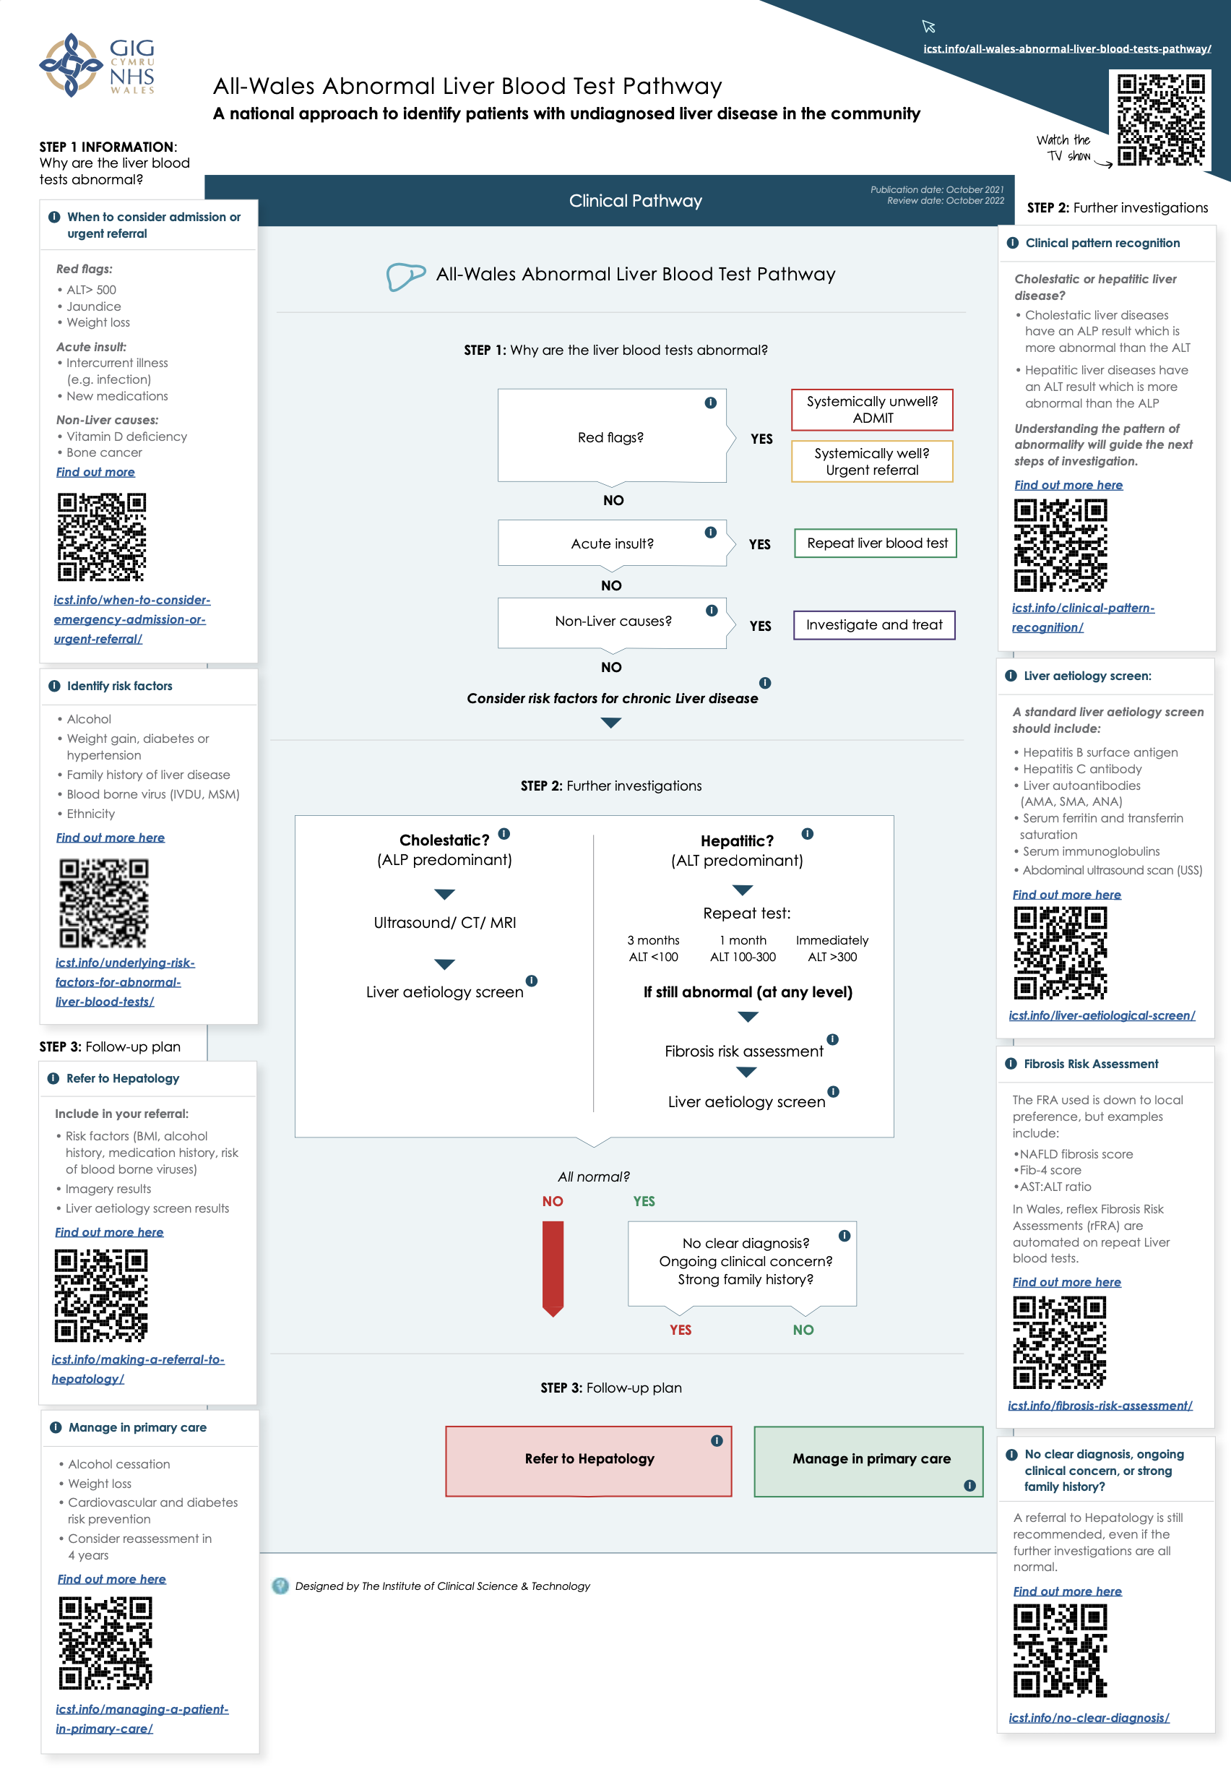

The All Wales Abnormal Liver Blood Tests Pathway
An All Wales Guideline developed by experts from within Wales
An interactive dynamic guideline to support primary care teams to recognise advanced disease (including cirrhosis) at a much earlier stage
Provide guidance to addresses the patient’s risk factors for liver disease, including alcohol cessation and weight management.
allwales.icst.org.uk

Slide 3
Rise in Liver disease mortality
While the number of deaths from other common conditions is falling in the UK, those due to liver disease have been increasing dramatically.
British Society of Gastroenterology (BSG) guideline
allwales.icst.org.uk

Slide 4
Burden of liver disease
Rise in Liver disease mortality
allwales.icst.org.uk

Slide 5
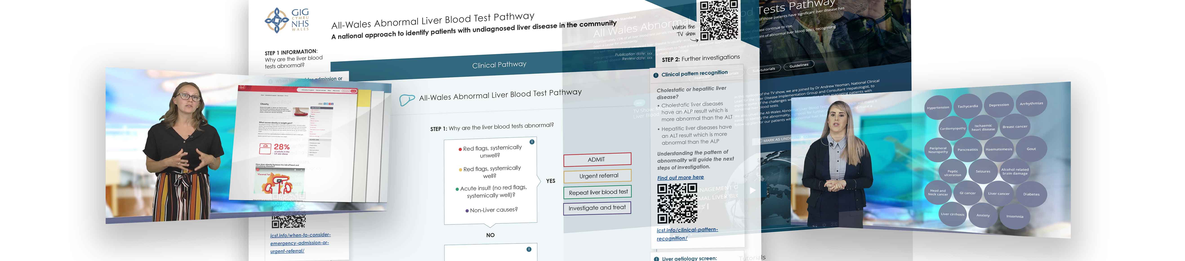
The Welsh Model
Deconstructing a complicated pathway into three simple steps
Supporting secondary care to increase secondary care diagnostic capacity, reducing waiting times for those patients who are found to be at high risk of advanced liver disease
This is a consistent approach taken by all Health boards in Wales
allwales.icst.org.uk

Slide 6
All Wales Abnormal Liver Blood Tests Pathway
The purpose of this pathway is to:
Make it easier to identify abnormality
Signpost for further investigations
Make a follow up plan for patients with abnormal liver blood tests
allwales.icst.org.uk

Slide 7
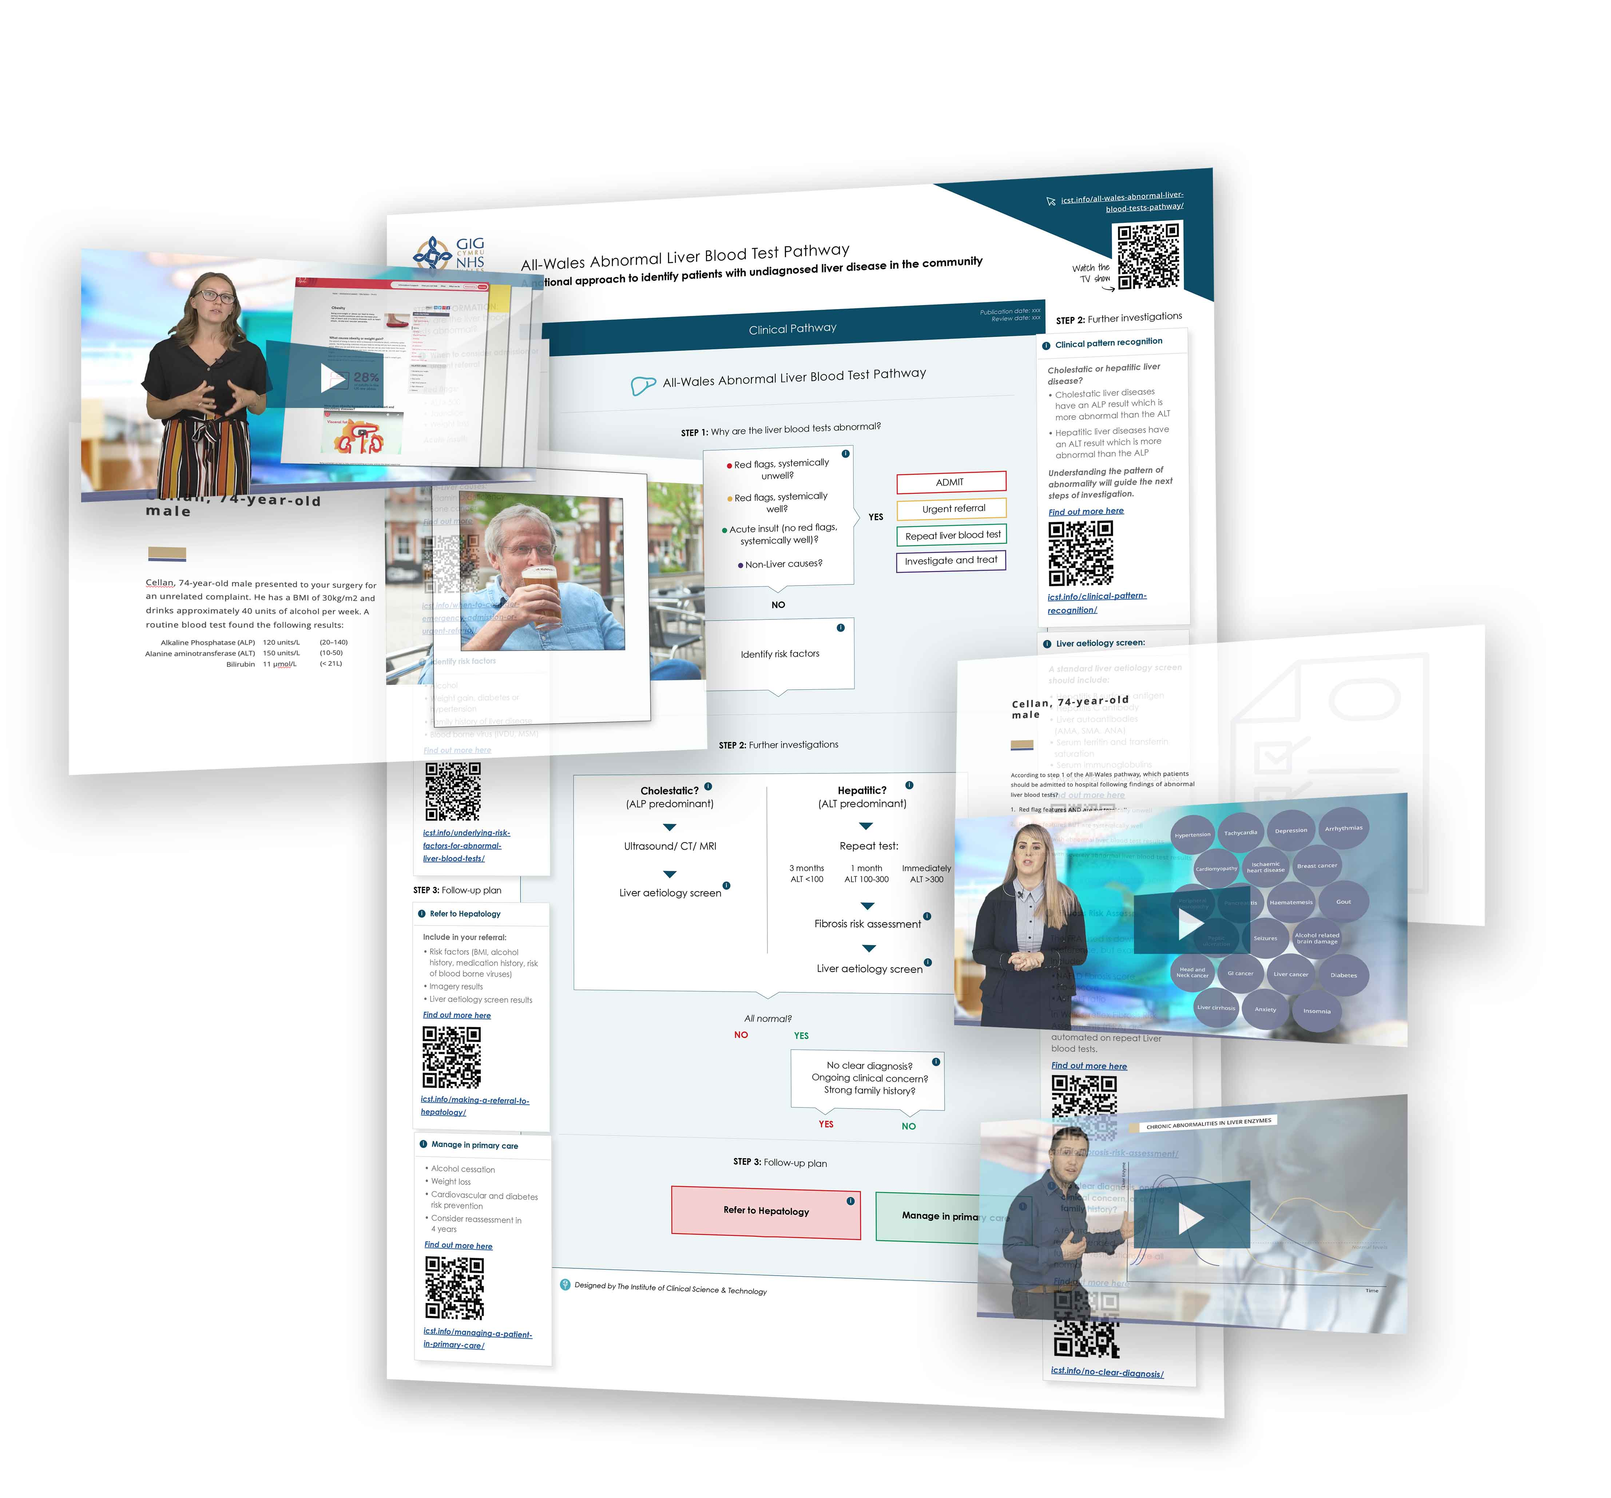
Key features
An interactive support tool for healthcare professionals across each of the seven Health Board
Structured guidance when the patient is in front of you
Relevant resources and research articles
Supplemental education and instruction from the experts
allwales.icst.org.uk

Slide 8

Supported by video education delivered by the experts from Wales and the UK
Differentiating between cholestatic and hepatitic abnormalities
Making a referral for a Fibroscan
Conditions that lead to abnormal liver blood tests
Managing patients in primary care who have a low risk of fibrosis
Significant fibrosis, what does it mean for the patient?
And much more when you explore it further, with updates
as new evidence emerges…

Slide 9
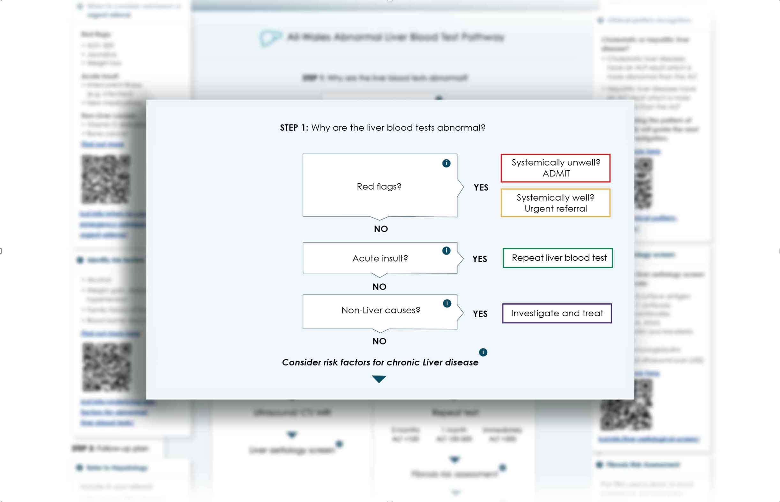
allwales.icst.org.uk
A structured approach to understand why my patient’s liver blood tests are abnormal
When to consider urgent admission, when to refer urgently to hepatology, when to repeat the LFT and when to investigate non-liver causes
allwales.icst.org.uk

Slide 10
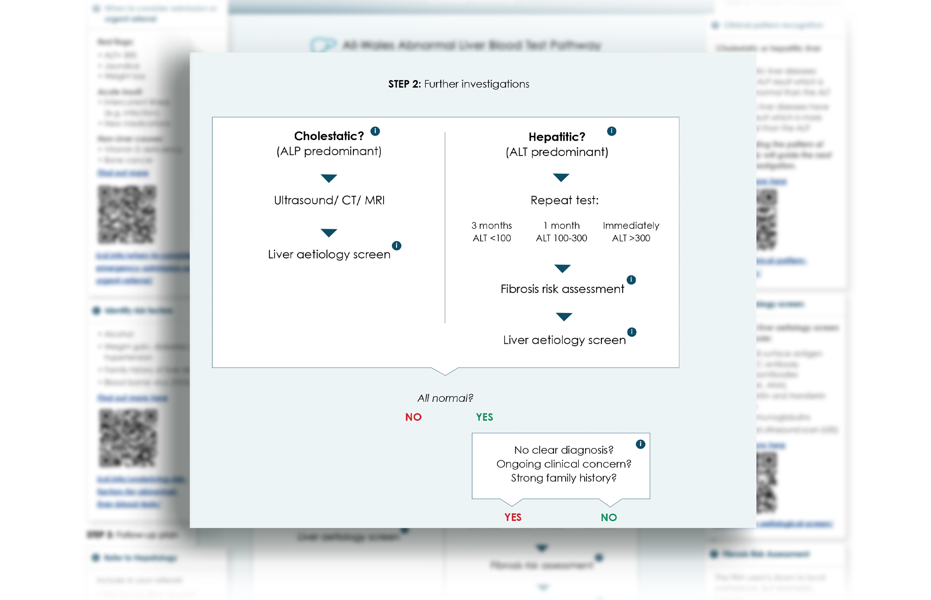
allwales.icst.org.uk
How to differentiate between patients with predominantly cholestatic abnormalities and predominantly hepatitic abnormalities
Structured approach to investigations that are relevant to the underlying liver disease
allwales.icst.org.uk

Slide 11
Reflex Fibrosis Risk Assessment (rFRA)
The All Wales Abnormal Liver Blood test pathway will facilitate a reflex Fibrosis Risk Assessment (rFRA).
When a second liver blood test finds abnormality on the ALT, an AST value is returned automatically.
The AST:ALT ratio is a fibrosis risk assessment, which assesses the patient’s risk of liver fibrosis. If the ratio is less than 1, the risk of liver disease is low. If the ratio is more than 1, the risk of liver fibrosis is high.
allwales.icst.org.uk
allwales.icst.org.uk

Slide 12
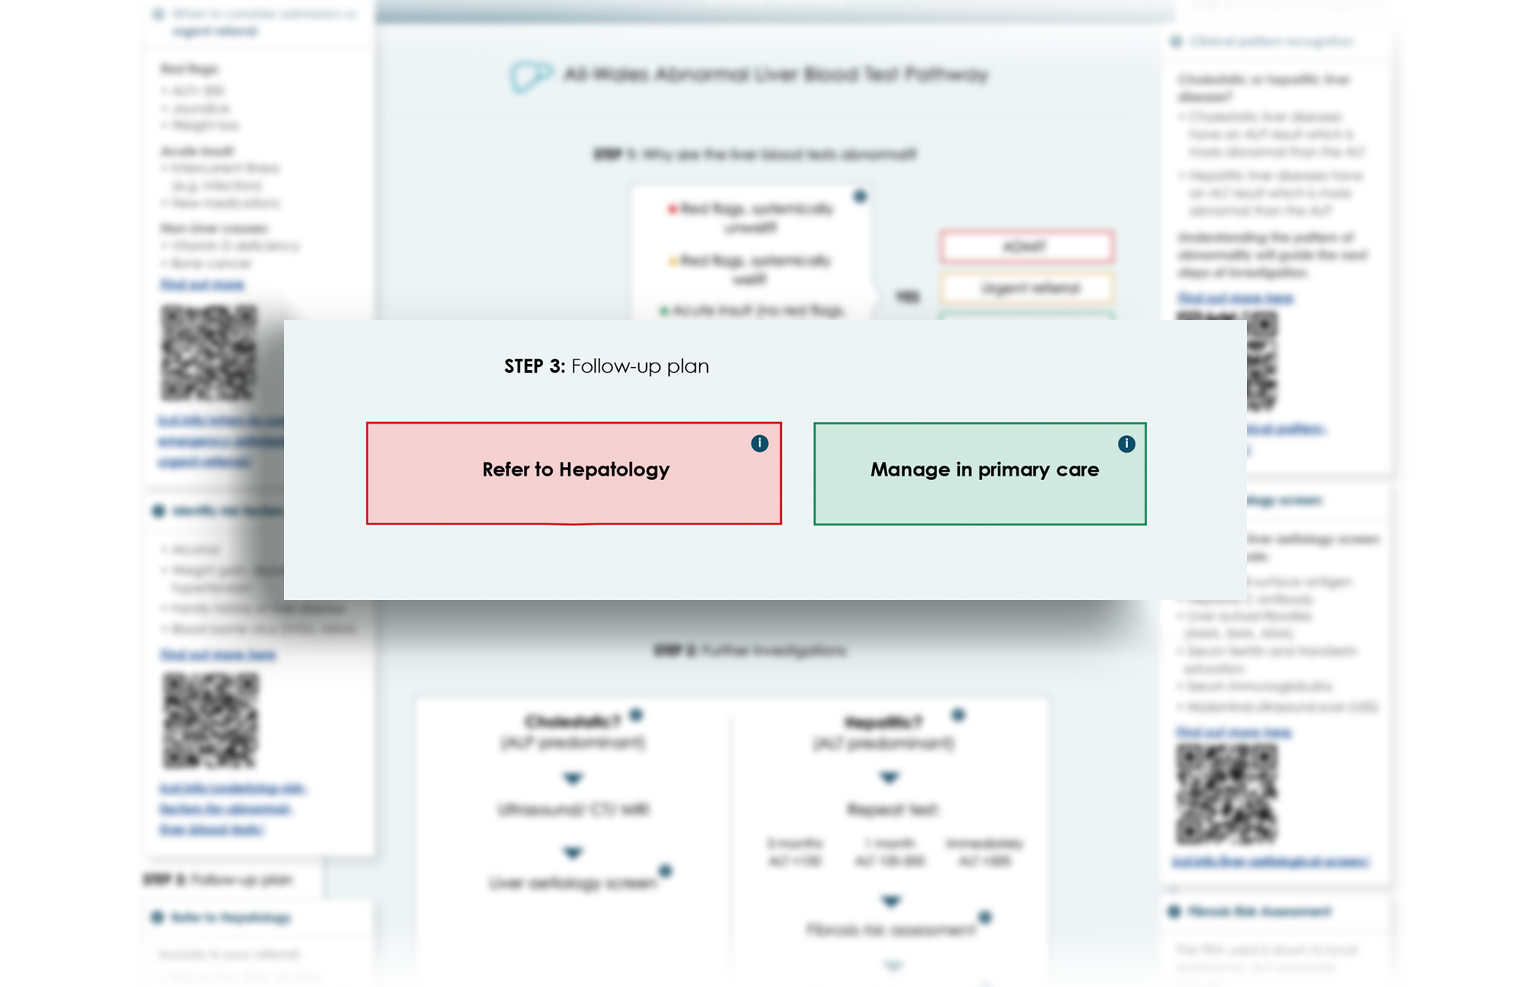
allwales.icst.org.uk
When to consider referral to Hepatology?
When to consider ongoing management in primary care to address the patient’s risk factors?
allwales.icst.org.uk

Slide 13
Question & Answers

